Slide 1

What are we going to see in this session?
About Playbooks
Hosts and Users
Privilege Escalation
Tasks list
Order control

Slide 2
About Playbooks
Playbooks are completely different way to use ansible than in ad-hoc execution mode.
Playbook is very powerful concept in Ansible.
Playbooks are the basis for real simple configuration management and multi machine deployment.
Playbooks are helpful and well suited to deploy complex applications.
Using playbook you can orchestrate steps of any manual process which you do in daily basis.
They can launch tasks synchronously and asynchronously.
Playbooks are more likely to be kept in source control and used to push out your configuration to remote machines.

Slide 3

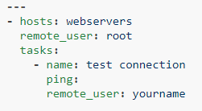
Hosts and Users
For each play in a playbook, you get to choose which machines in your infrastructure to target and what remote user to complete the tasks.
The [hosts] line is a list of one or more groups or host patterns, separated by colons.
The [remote_user] is just the name of the user account.
You can also define remote users per tasks

Slide 4

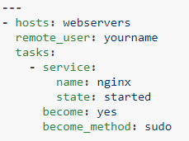
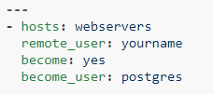

Privilege Escalation
Ansible supports for running things as another user with Privilege Escalation.
You can also use keyword become on a particular task instead of the whole play.
You can also login as you and then become a different user other then root.
You can also use other privilege escalation methods, like [su] if required.

Slide 5
Task List
Each play contain a list of Tasks.
Tasks are executed in order, one at a time against all machines mentioned in host file.
Every tasks should have name, which is displayed in the output while running the playbook.
The output is very much human readable, so it is very useful to provide good description for each tasks.

Slide 6
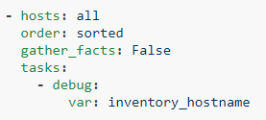
Order control
You can also control the order in which hosts should run.
Possible values for order are:
Inventory: The default. The order is ‘as provided’ by the inventory
reverse_inventory: As the name implies, this reverses the order ‘as provided’ by the inventory
sorted: Hosts are alphabetically sorted by name
reverse_sorted: Hosts are sorted by name in reverse alphabetical order
shuffle: Hosts are randomly ordered each run

Slide 7

End of this topic !
Any questions?

